Slide 1
Image Intensity Transformation and Image Enhancement
AJIT RAJWADE
CS 663

Slide 2
Intensity transformations
Consider an image I(x,y).
An intensity transformation refers to the transformation applied to individual image intensities to yield a transformed image of the form: J(x,y) = T(I(x,y)) where T(.) is a transformation operator.
For example: J(x,y) = [I(x,y)]² or J(x,y) = I(x,y)-I(x,y+1)
In the latter case, the transformation makes use of other pixel values, usually from the neighborhood of the pixel (x,y).

Slide 3
Image Enhancement
Defined as the process of manipulating image intensities, so that the resulting image is more visually suitable for a specific application.
The quality of an image enhancement algorithm is judged by the perception of the end-user.

Slide 4
Popular image transformations
Image Negatives
Logarithm and Power Law transformations
Contrast Stretching
Bit-plane slicing
Histogram Equalization
Histogram Specification

Slide 5
Image Negatives
Let an image have intensity range [0,L-1].
The negative transformation has the form s(r)=L-1-r where s,r = output, input intensity level.
This reverses the intensity levels of an image – equivalent of a photographic negative
This can produce an enhancing effect – to enhance grayish detail on dark background.

Slide 6
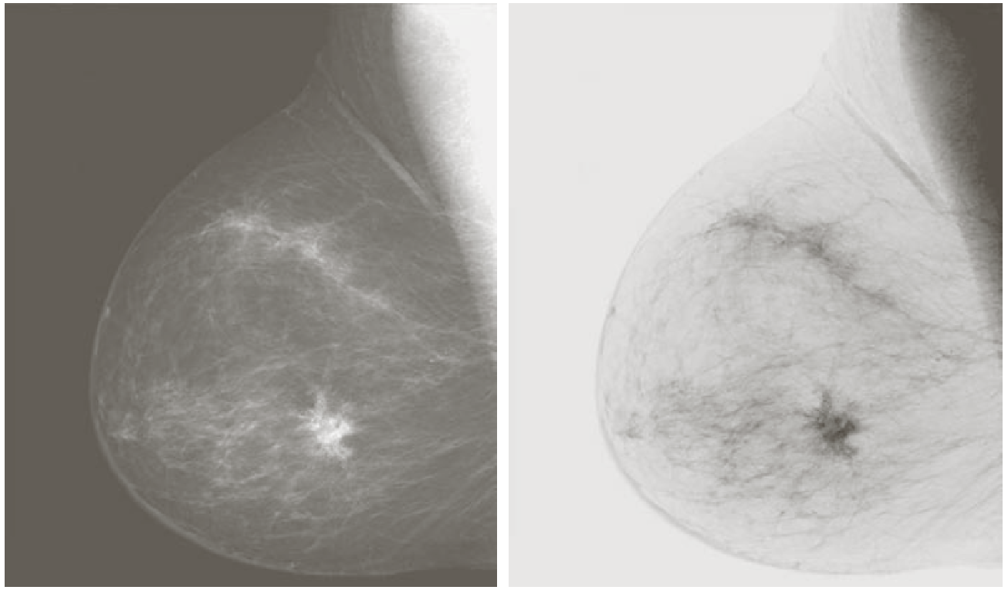
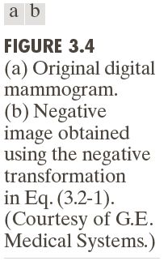

Slide 7
Logarithmic transformation
Has the form s(r) = c log(1+r) where s,r = output, input intensity level assuming r >= 0 and c is some constant.
It maps a narrow range of low intensity values to a wider range.
It maps a range of high intensity values to a narrow range.
This can be observed from the graphs on the next slide.

Slide 8
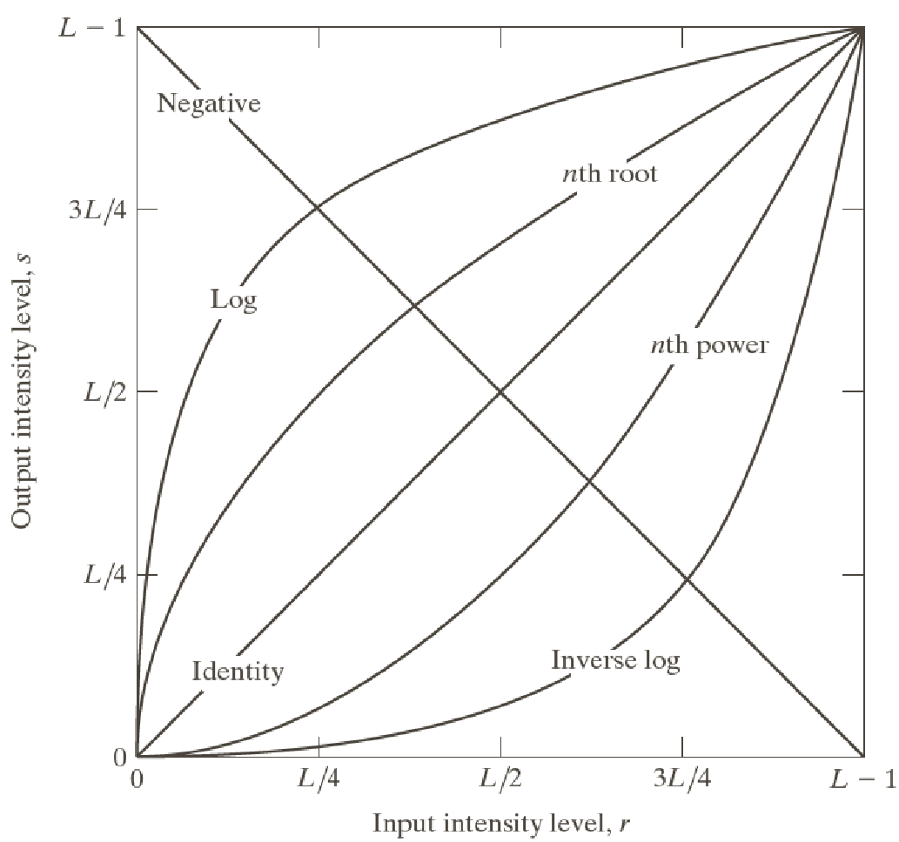
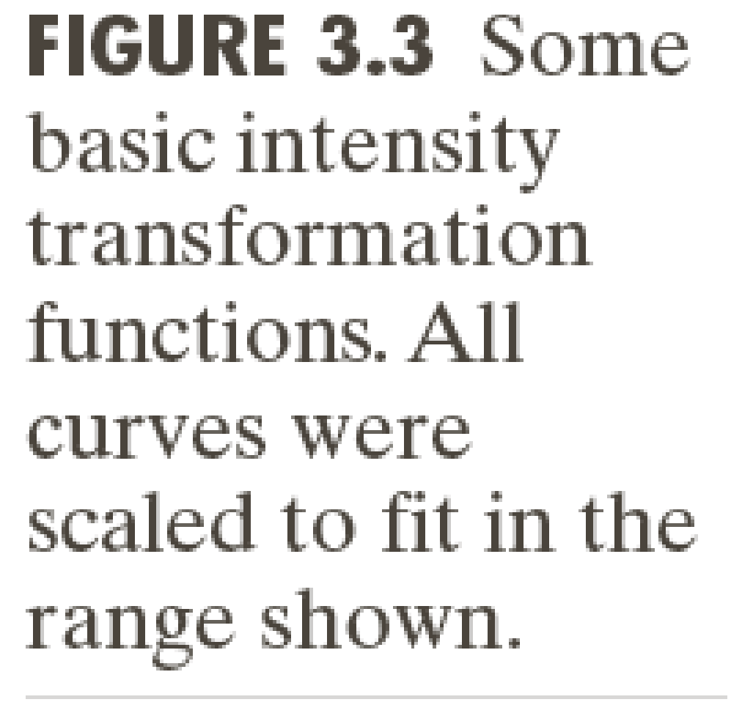

Slide 9
Logarithmic transformations
A logarithmic transformation compresses the intensity range of images whose initial intensity range is very wide.
For example, the Fourier spectrum of an image (we will study these later in class) often has intensities ranging from close to 0 to 10⁷.
Displaying the original intensities of the Fourier spectrum as is, causes a huge loss of detail.
A log transformation of the intensities allows perception of a great deal of detail (on the same display system). See next slide.

Slide 10
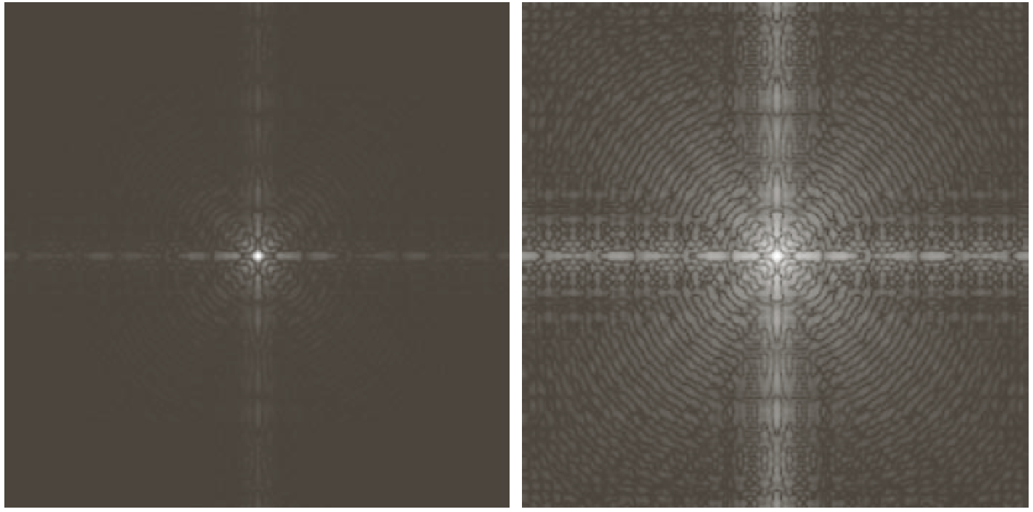
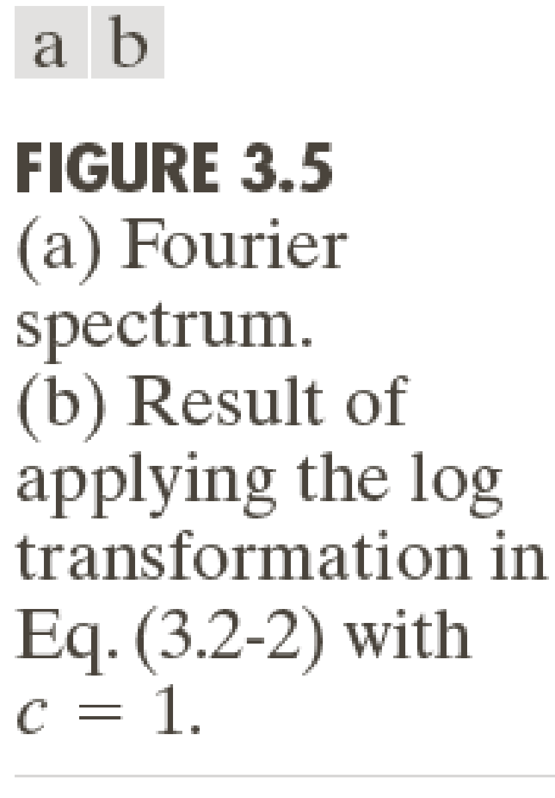
When we do Fourier transforms later in class, we will make heavy use of log(r+1) type transformations.
Note: the 1 in log(r+1) is used for stabilization since log 0 is undefined. In some applications, if there are intensity values which are very tiny which need to be preserved, the 1 should be replaced by some ε value which is several times smaller than the smallest non-zero value.

Slide 11
Power-Law (Gamma) Transformation
This is a transformation of the form s(r) = cr^{γ}.
Here, c > 0 is a constant, r is the input intensity and γ > 0 is a constant for the power law.
For fractional values of γ (between 0 to 1), a narrow range of low intensity values gets mapped to a wider range, and a range of high intensity values gets mapped to a narrower range.
The effect is similar in principle to the log transformation, but we have more flexibility here as we can tune γ per our liking.

Slide 12
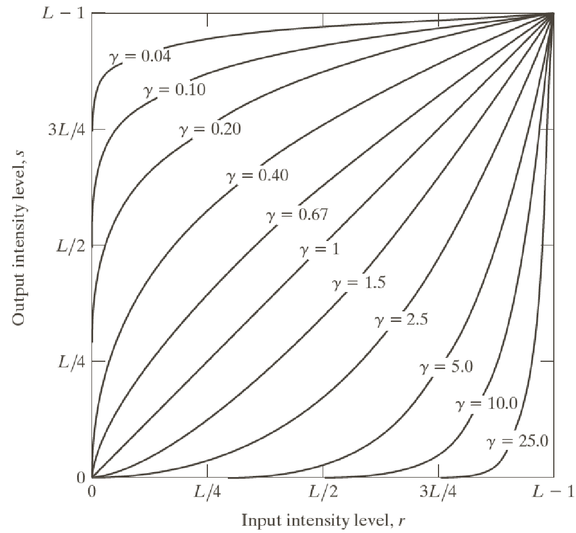
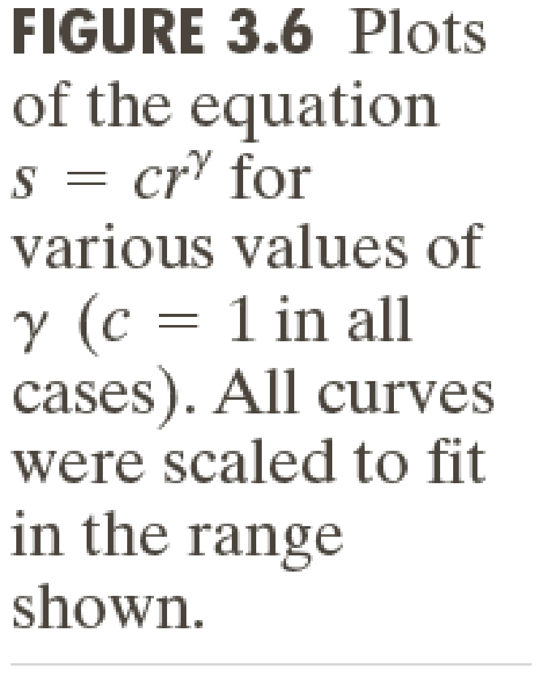
Note: The curves have been scaled to the range [0,L-1] after applying the gamma transformation. This has the effect of enhancing brighter intensities when gamma is more than 1.

Slide 13
Power-Law (Gamma) Transformation
Many devices for display or printing work as per a power law.
For example, a cathode ray tube (CRT) has an input intensity to output voltage mapping that uses a power law with γ between 1.8 to 2.5.
Since the brightness of the pixel perceived on a CRT monitor depends on the voltage, it ends up producing images that are darker than intended to be (See next slide), i.e. the system displays cr^{γ} instead of r and hence brighter values dominate.
Hence the image is pre-processed before inputting to the display system of the computer in the following manner: s(r) = (r/c) ^{1/γ} based on the gamma value (γ) of the display system.
The output voltage values will be cs^{γ} = c[(r/c) ^{1/γ} ] ^{γ} = r as intended to be.

Slide 14
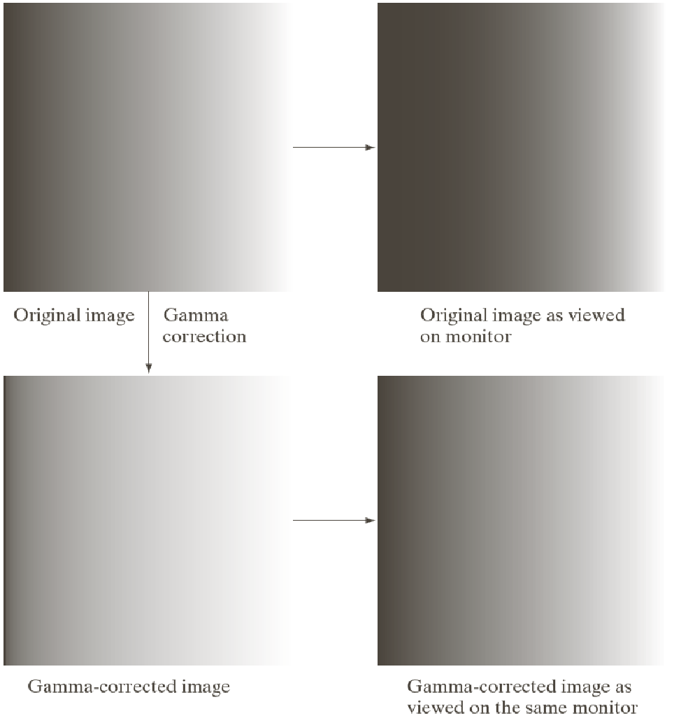
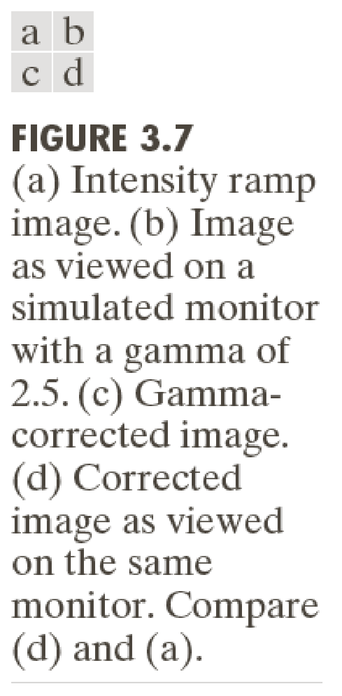

Slide 15
Power-Law (Gamma) Transformation
The aforementioned transformation is called gamma correction.
It is performed internally by the display system (oblivious to the end-user).
Power-law transformations are also used for general “contrast enhancement” apart from gamma correction.

Slide 16
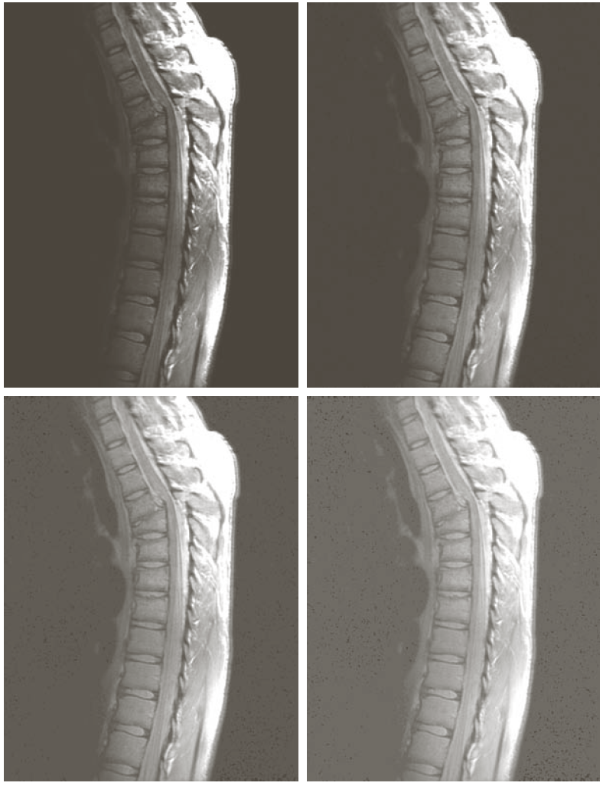
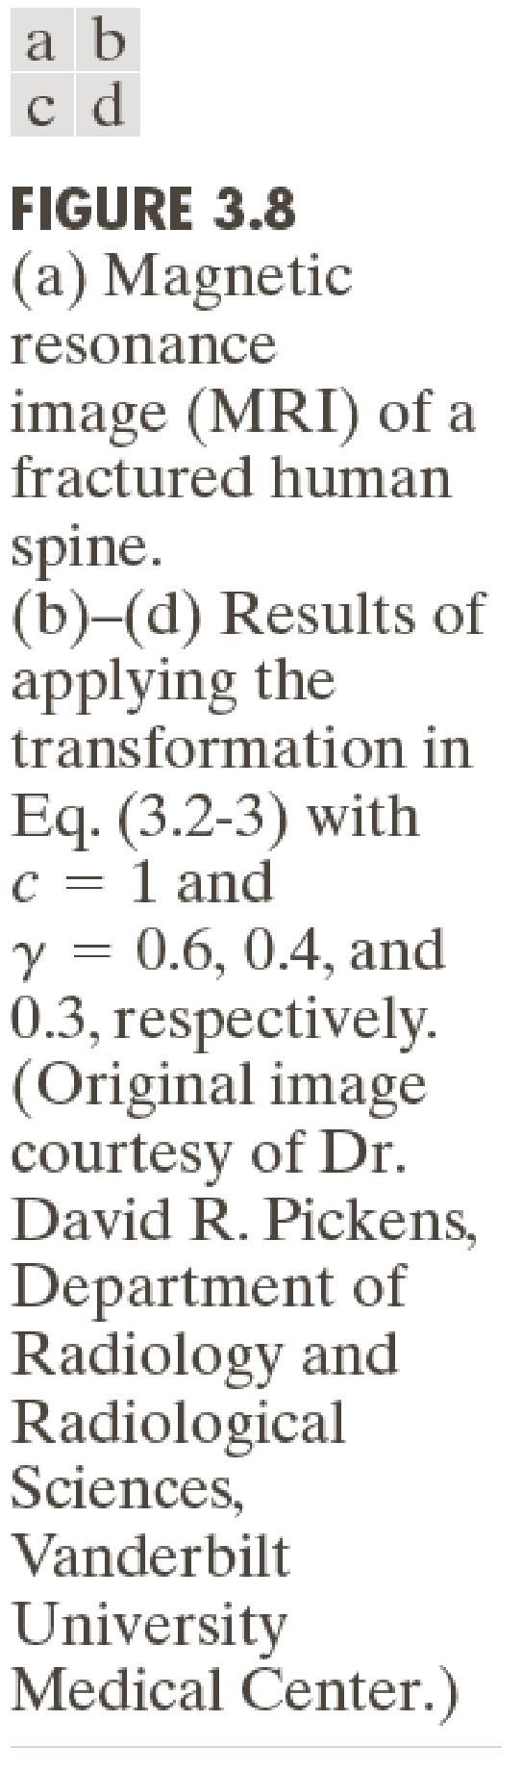

Slide 17
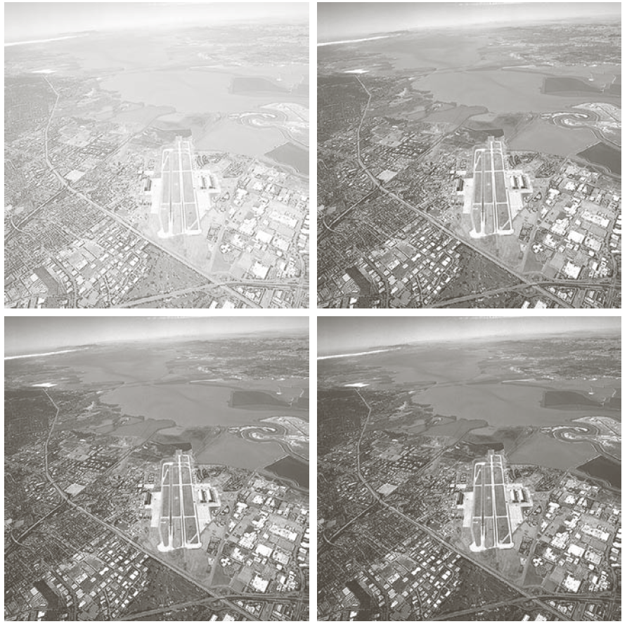
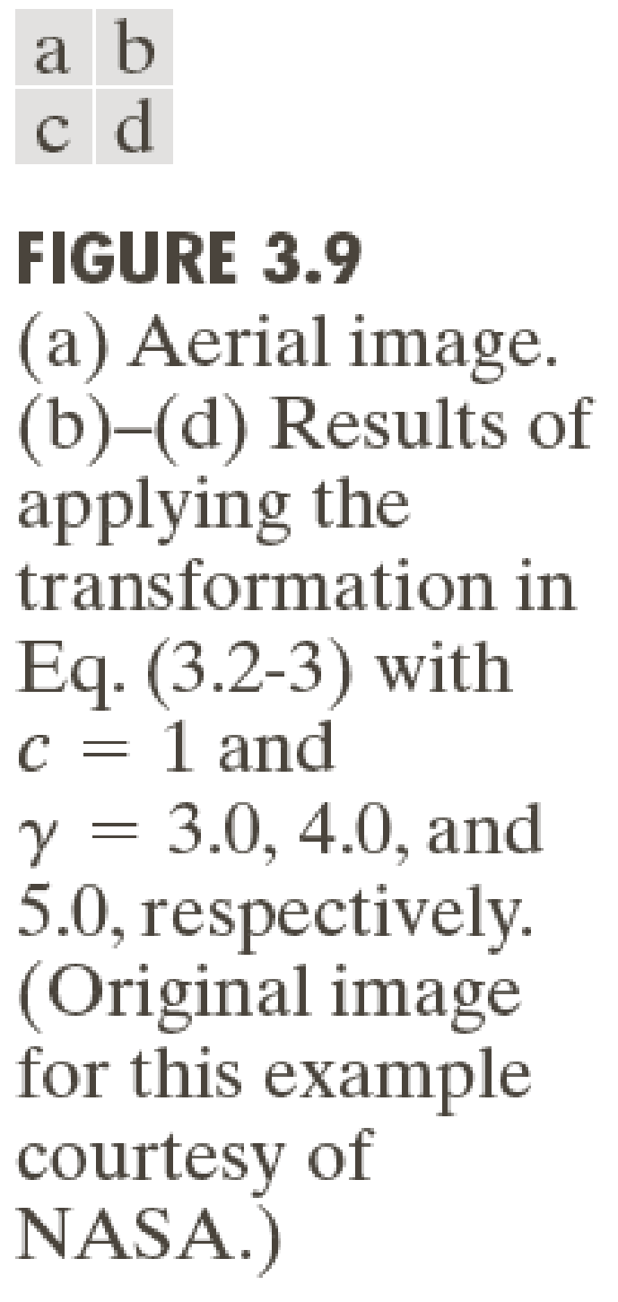

Slide 18
Contrast Stretching
Low-contrast images occur due to poor lighting or low dynamic range of the camera sensor.
Contrast stretching expands the intensity range in an image so that it spans the full intensity range of the display medium.
For example suppose image I has range from [r_{min}, r_{max}] whereas the range of the device is [0,L].
In the most basic form of contrast stretching, we perform: s(r) = (L-1)(r- r_{min})/(r_{max}- r_{min}) so that r_{min} is mapped to 0 and r_{max} is mapped to L-1.

Slide 19
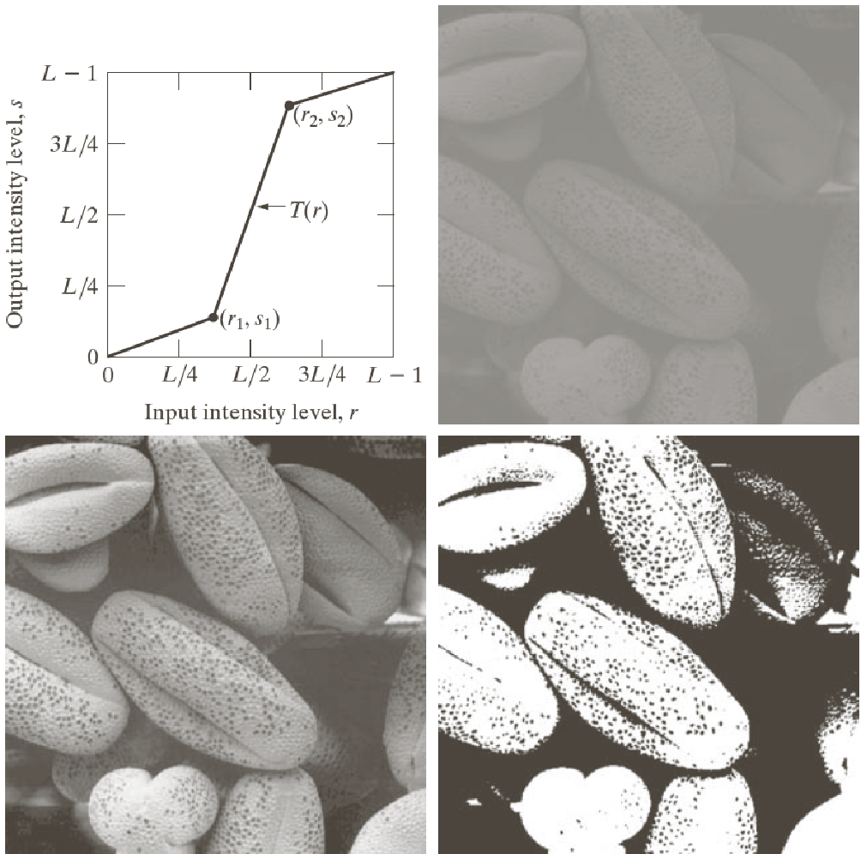
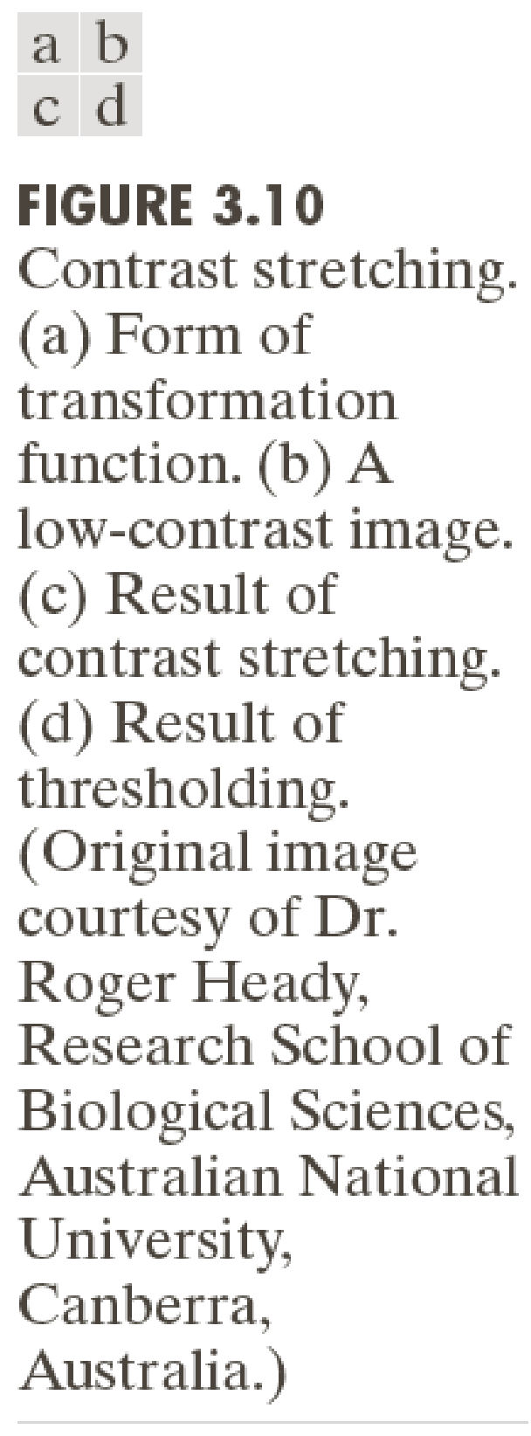
Ignore the yellowed out images

Slide 20
Bit-plane slicing
Pixel values are usually 8-bit integers in photographic images.
Thus at each pixel location, we have 8 bits defined.
Such an image can be considered as being composed of eight 1-bit planes – each plane being a binary image.

Slide 21
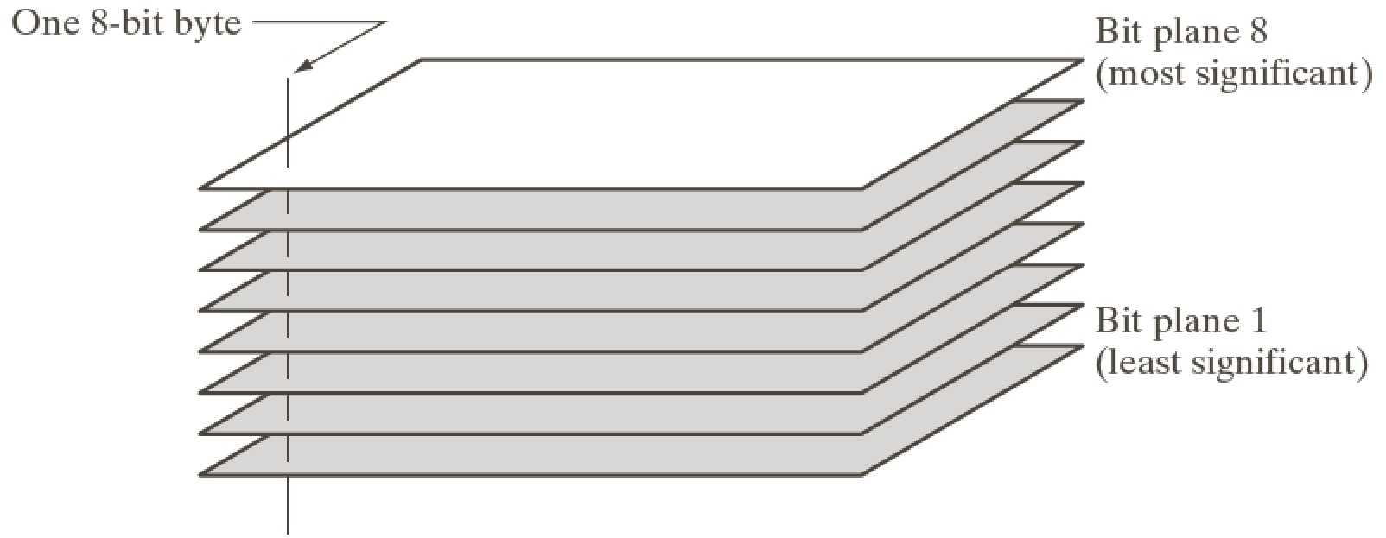
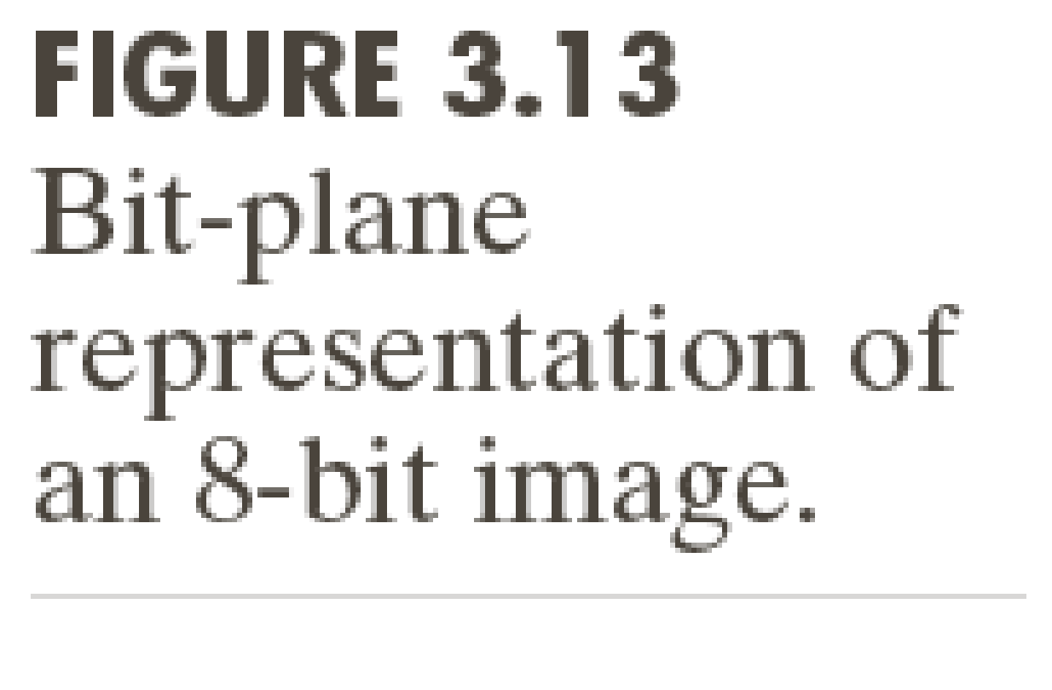
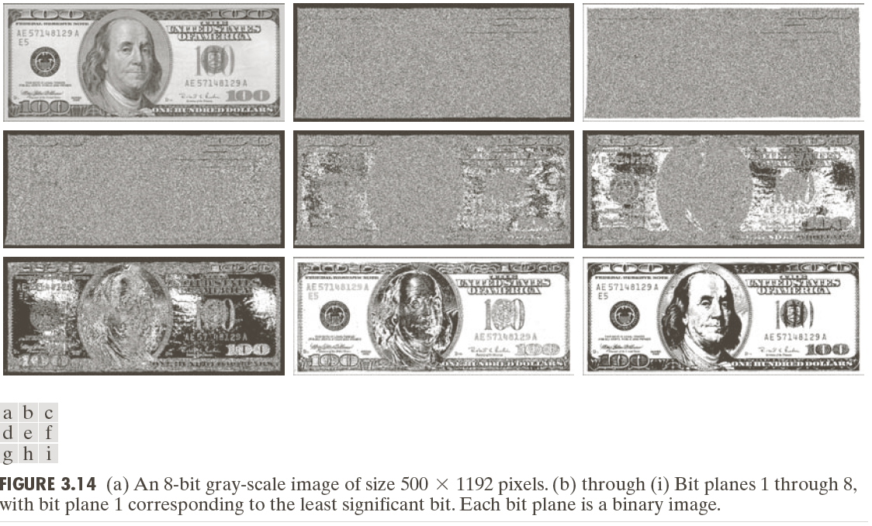

Slide 22
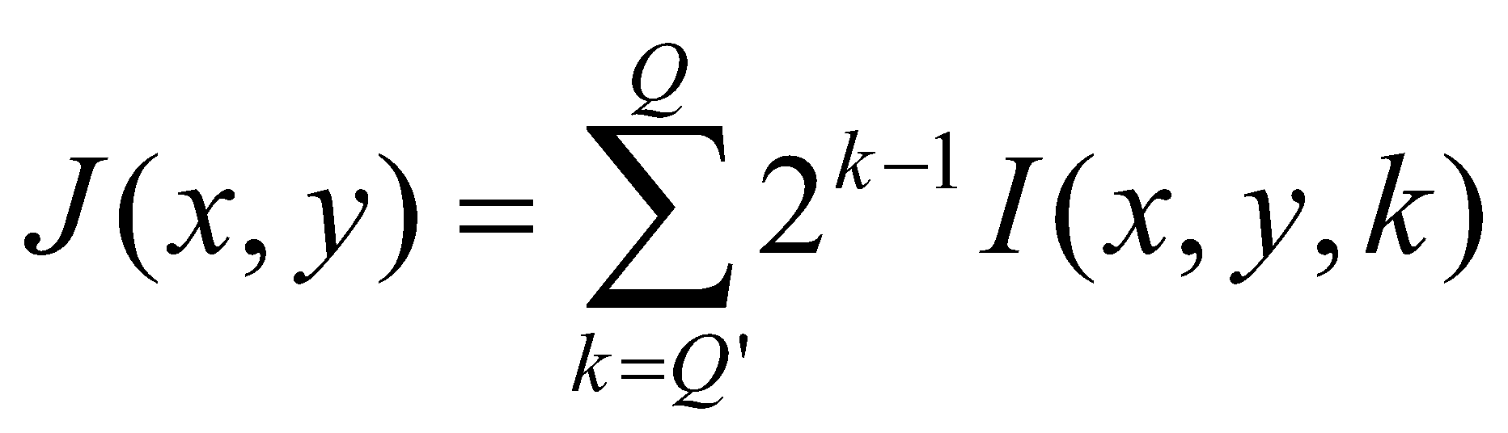
Bit slicing
From the previous example, we see that the first 4 most significant bits carry most of the image information.
The 4 least significant bits carry less information and mostly subtle texture, even resembling noise.
One can compress an image (with some loss!) by using the most significant bits from Q’ to Q, as follows:
k-th bit-plane image

Slide 23
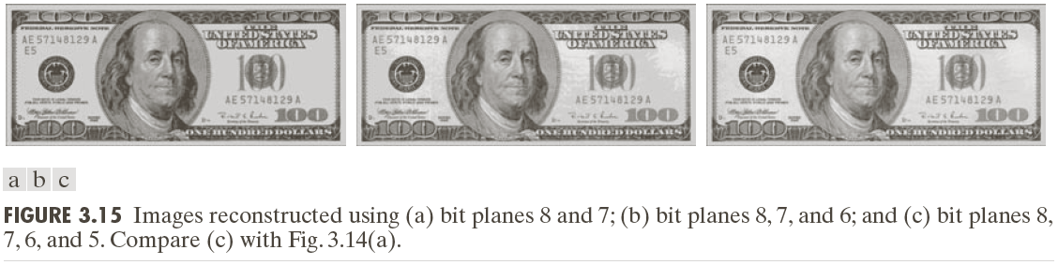

Slide 24
Parameter selection in image enhancement
All aforementioned techniques are intended to improve the (subjective) visual appeal of the image.
The choice of various parameters in these techniques (eg: γin power-law) therefore depends on the user.
It can be considered creative user choice.

Slide 25
Parameter selection in image enchancement
Here image enhancement differs from image restoration (which we will study later in a different chapter).
In the latter, we model a degradation phenomenon (eg: image blurring) and seek to inverts its effect.

Slide 26

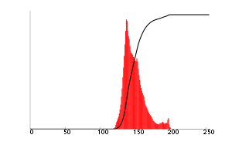
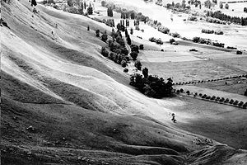
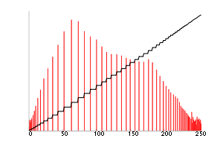
Histogram equalization
http://en.wikipedia.org/wiki/Histogram_equalization
A method to improve image contrast
Low contrast image: histogram is narrow
High contrast image: histogram is more spread out!
Image has higher dynamic range – details more clearly visible

Slide 27
Histogram equalization
Seeks to apply an intensity transformation to the pixel intensities of a low-contrast image so as to convert it into one with a (nearly) uniform histogram.
A uniform histogram is a histogram with Q bins where the probability mass in each bin is 1/Q.
Principle: images with uniform histogram (or more spread out histograms) will have better contrast.
Consider S = T(R), where R = random variable standing for intensity in the original image (assume r lies from 0 to L-1).

Slide 28
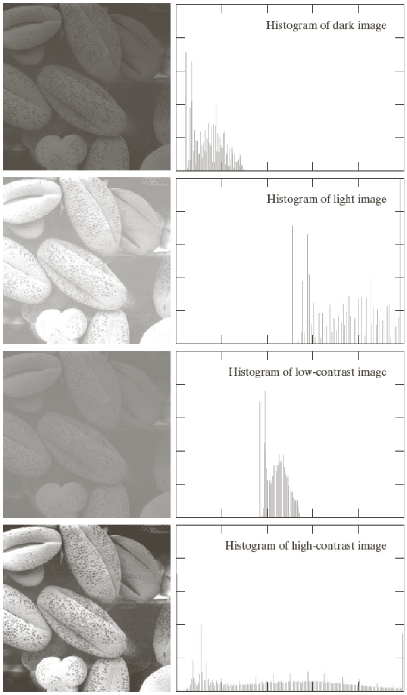

Slide 29
Histogram equalization
Consider S = T(R), where R = random variable standing for intensity in the original image (assume R lies from 0 to L-1).
S stands for the transformed random variable.
The values that S and R acquire are denoted as s, r respectively.
In particular, we are interested in T which satisfies the following two conditions:
It should be strictly monotonically increasing
If 0 <= r <= L-1, then 0 <= T(r) <= L-1 as well.

Slide 30
Segway: Probability refresher
A random variable is the outcome of a randomized experiment.
Eg: the number of heads appearing in N independent coin tosses, the time at which the first head appears in N independent coin tosses, etc.
A random variable is denoted by upper case alphabets and its values with lower cases.
A random variable may be discrete or continuous valued.
It is characterized by its Probability density function (PDF) in continuous cases or its Probability mass function (PMF) in discrete cases.
Denoted as p_{R}(r) – acquires values between 0 and 1 and integrates to 1.

Slide 31
Histogram equalization
The monotonicity condition prevents artifacts due to intensity reversals.
The second condition prevents change of the intensity range of the image.

Slide 32
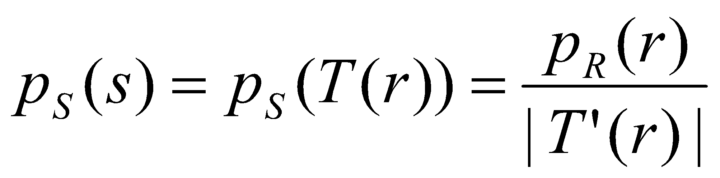
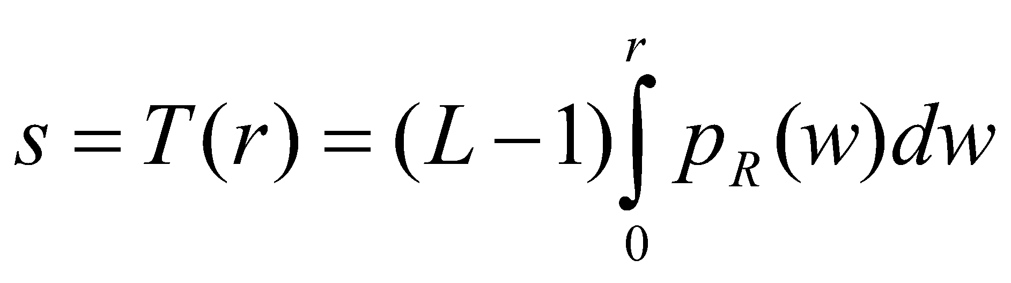
Histogram equalization
If R has a probability density p_{R}(r), then S has the following probability density:
Consider the following transformation:
Called “transformation of random variables” (eg: https://www.math.arizona.edu/~jwatkins/f-transform.pdf )
This formula requires T(r) to be one-one and hence monotonically increasing (or decreasing)
Cumulative distribution function (cdf) of R. It satisfies the monotonicity as well as range-based criteria mentioned earlier.

Slide 33
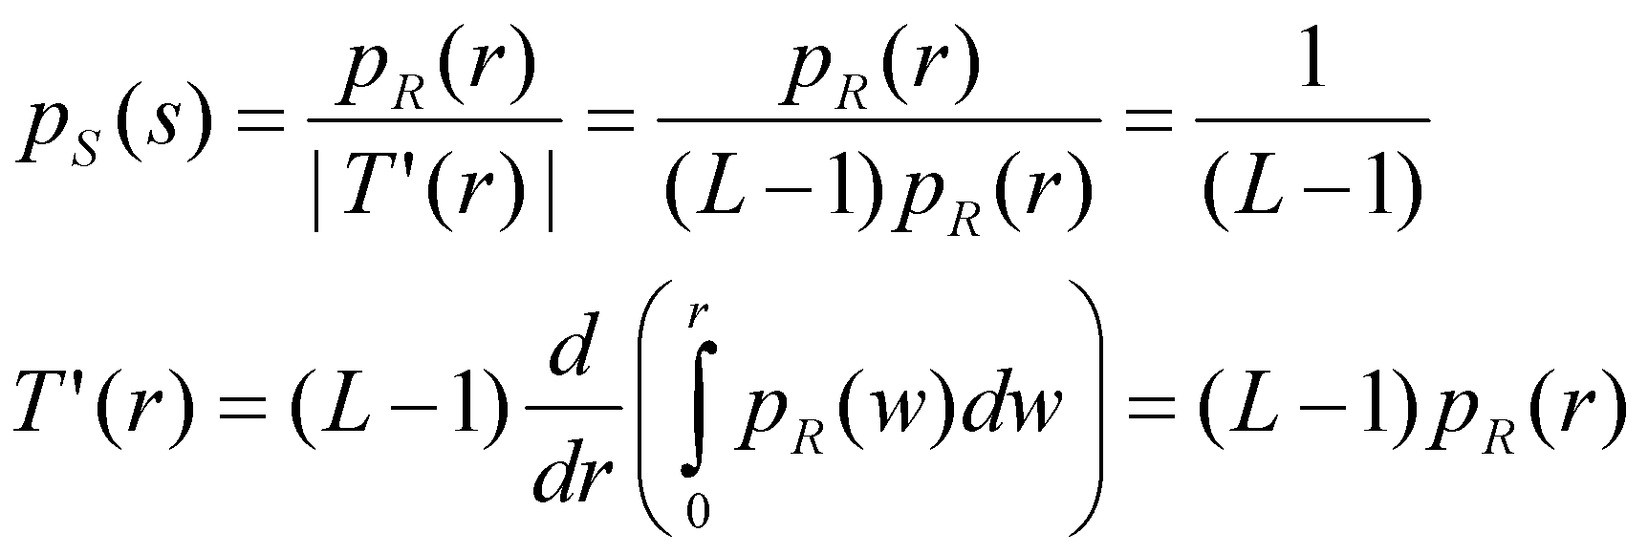
Histogram equalization
Then, we can show that the probability density of S is given as:
Thus S has a uniform PDF, independent of the original PDF of R.

Slide 34
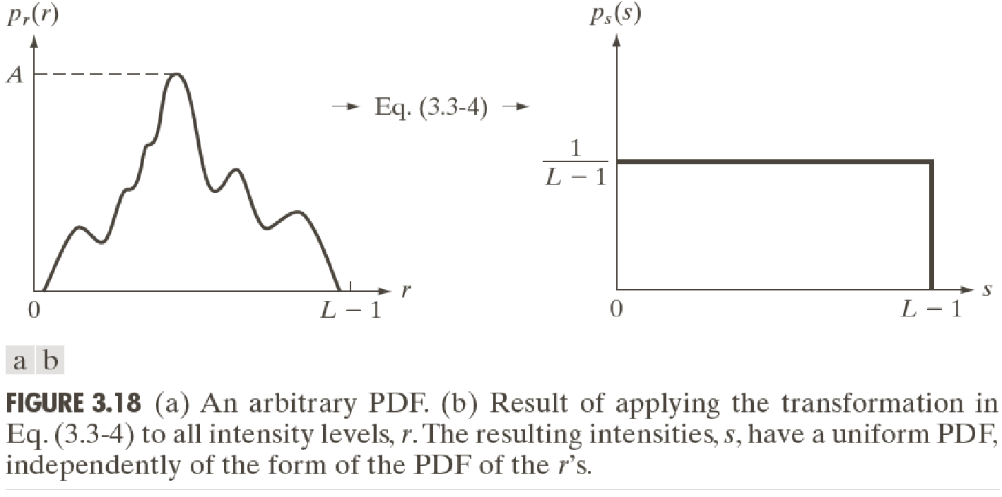

Slide 35
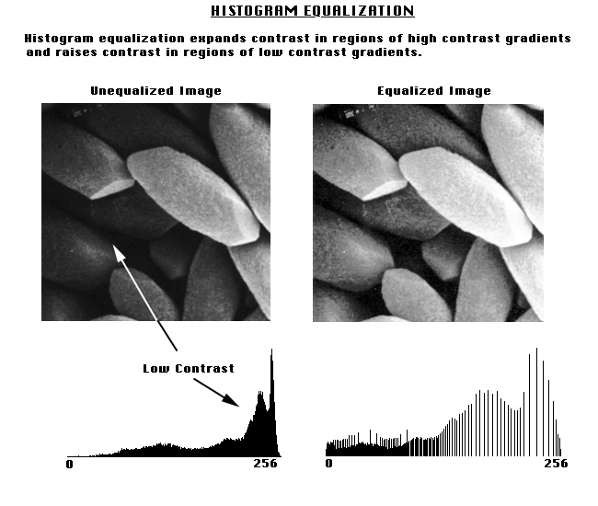
Histogram equalization
Thus to perform this procedure, replace intensity value r in an image by the cumulative density (cdf) of r, times the maximum intensity level in the image minus 1!
http://www.udel.edu/biology/Wags/b617/digital/digital14.gif

Slide 36
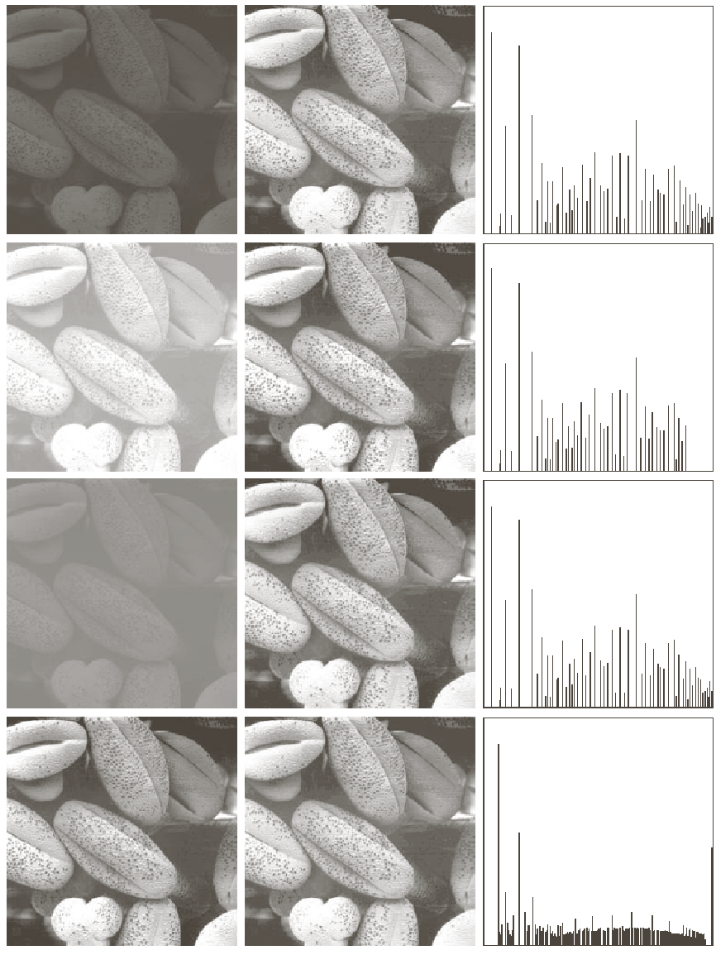

Slide 37
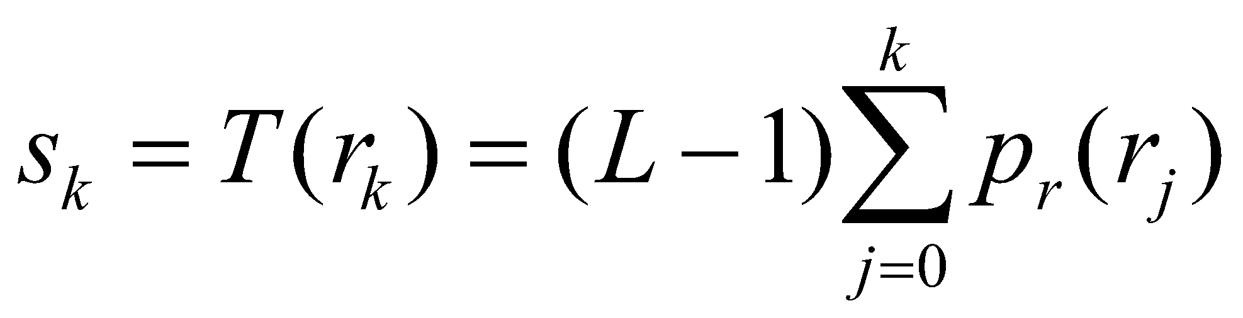
Histogram equalization
When you implement this, we change the integrals to a discrete summation.
Thus we have:
Thus you go to each pixel with value r_{k}, replace it by s_{k}, and repeat this for every intensity value r_{k}.

Slide 38
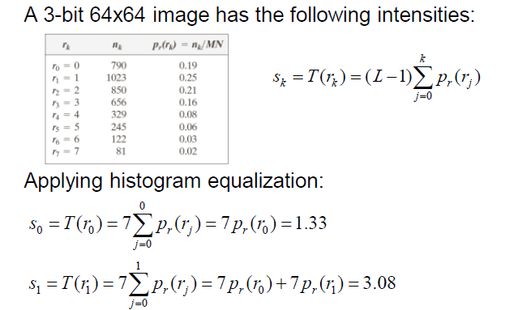
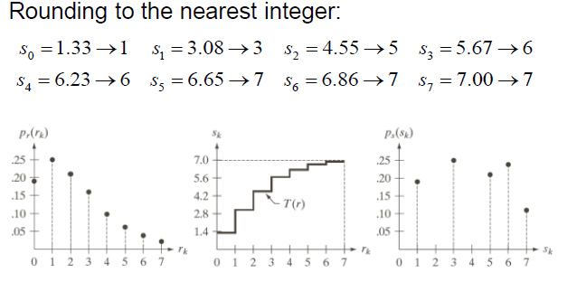

Slide 39
Histogram equalization
The discrete histogram of an equalized image is more spread out. But it is not exactly uniform.
Why?
Quantization (rounding off) of intensity values
Intensity range missing in the original image

Slide 40
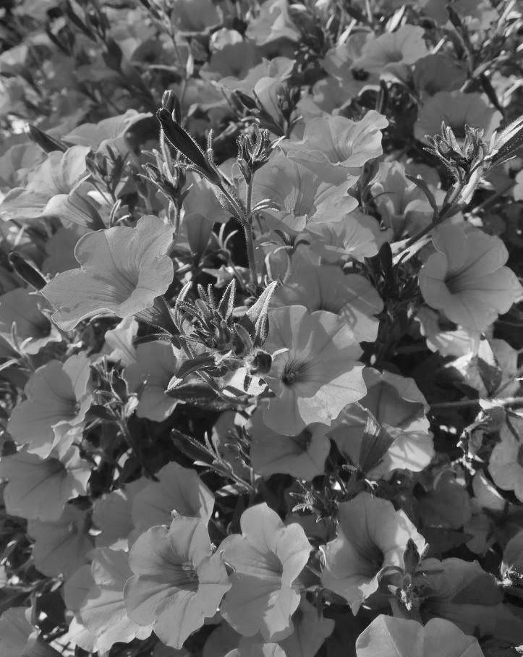
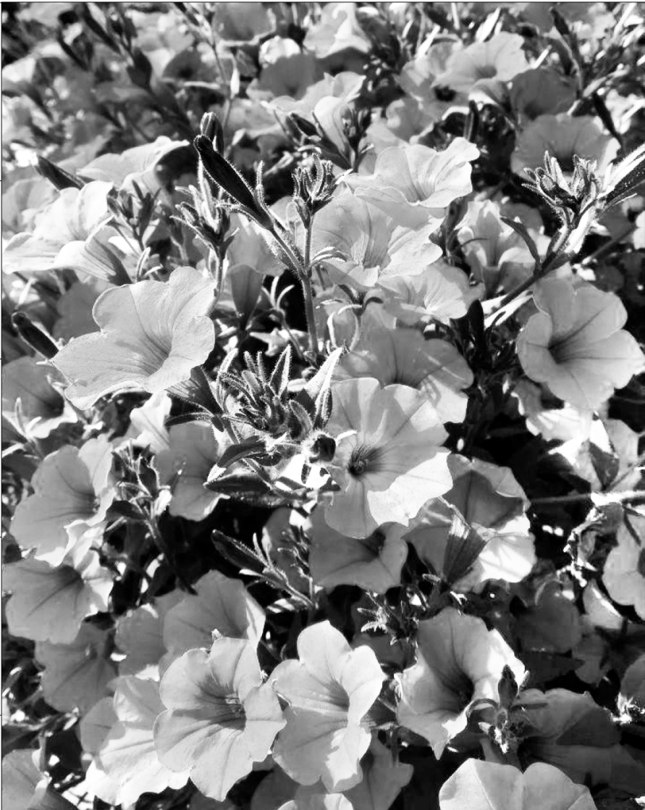
https://towardsdatascience.com/histogram-matching-ee3a67b4cbc1

Slide 41
Histogram specification (also called matching)
Apply an intensity transformation to an existing image so that the resultant image has some pre-specified histogram (perhaps corresponding to some other image).
Equalization – special case of specification where the pre-specified histogram is the uniform histogram!

Slide 42
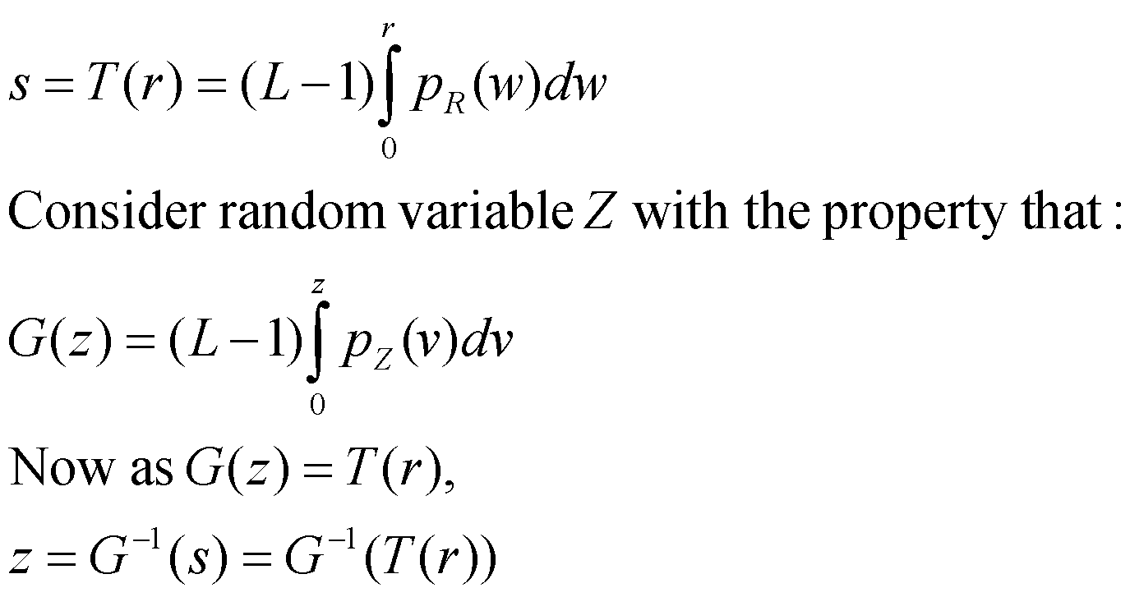
Histogram specification
Let p_{R}(r) = histogram of the original image.
Let p_{Z}(z) = pre-specified histogram.
We apply the following transformation to r:

Slide 43
Histogram specification
The pdf of the transformed image will be p_{Z}(z).
Problem: the specified histogram needs to be chosen carefully – by trial and error.

Slide 44
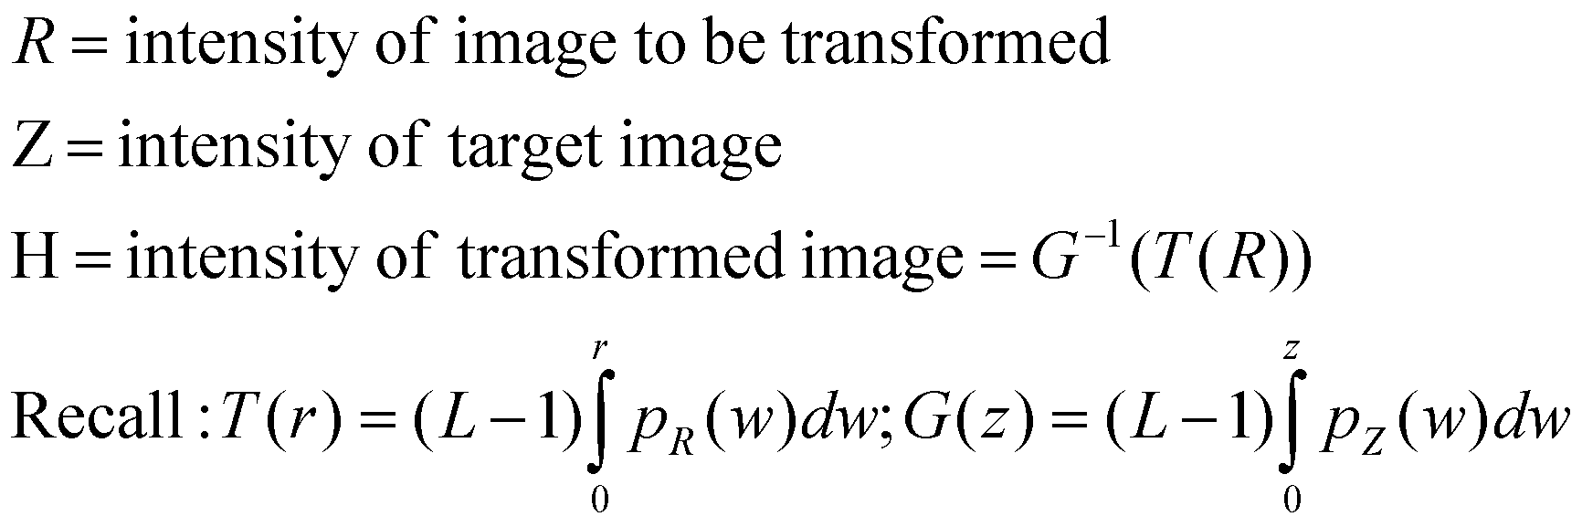
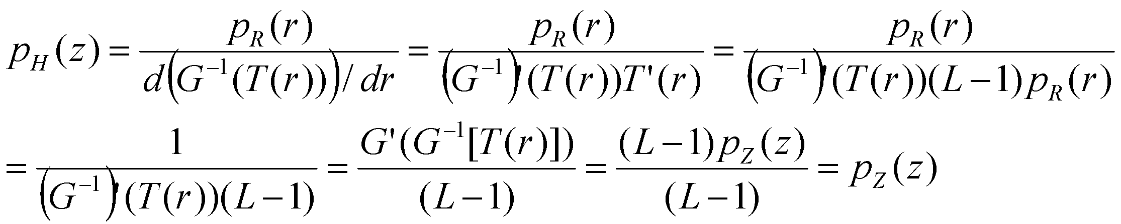
Proof
Recall that G⁻¹(T(r)) = z from the previous slide. Also G’(z) = (L-1)p_{Z}(z)
Chain rule
Inverse function theorem

Slide 45
Histogram specification
Let R be the image which needs to be transformed so that its histogram will now resemble the histogram of image Z.
Compute p_{R}(r) and p_{Z}(z).
Compute the functions s = T(r) and G(z). Then compute G⁻¹(s) .
The histogram of the transformed image containing values G⁻¹(s) will have PDF p_{Z}(z).

Slide 46
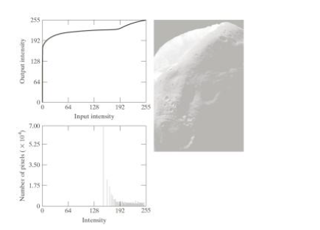
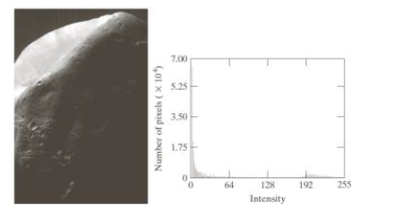
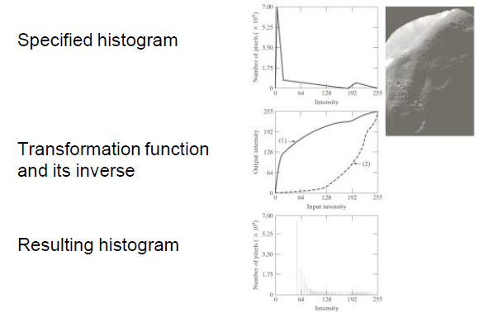
Equalization

Slide 47
Histogram specification versus equalization
Histogram equalization produces an image with a washed out appearance.
Why?
The original image histogram has a number of dark pixels, followed by an empty range, and a moderate number of bright pixels.
HE maps a narrow interval of dark pixels to the brighter side of the grayscale range (see the associated transformation function on the previous slide), causing a washed out appearance.

Slide 48
Histogram specification versus equalization
We want a target histogram which has a smoother transition from dark to light pixels.
Hence the particular histogram chosen on the previous slides.
Notice that this produces an image with improved appearance.
Read example 3.9 of the textbook by Gonzalez.

Slide 49

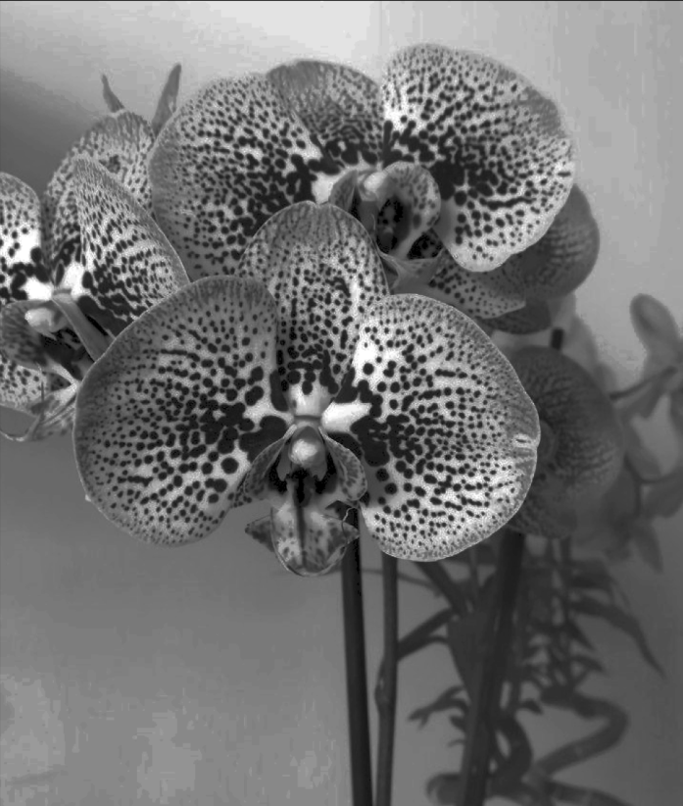
https://towardsdatascience.com/histogram-matching-ee3a67b4cbc1

Slide 50
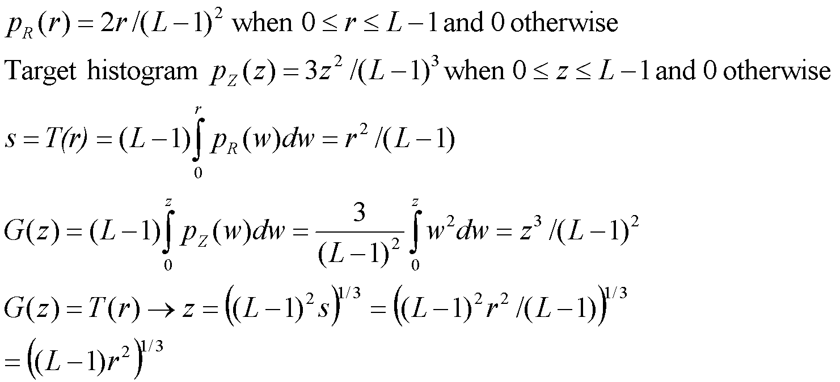
Example

Slide 51
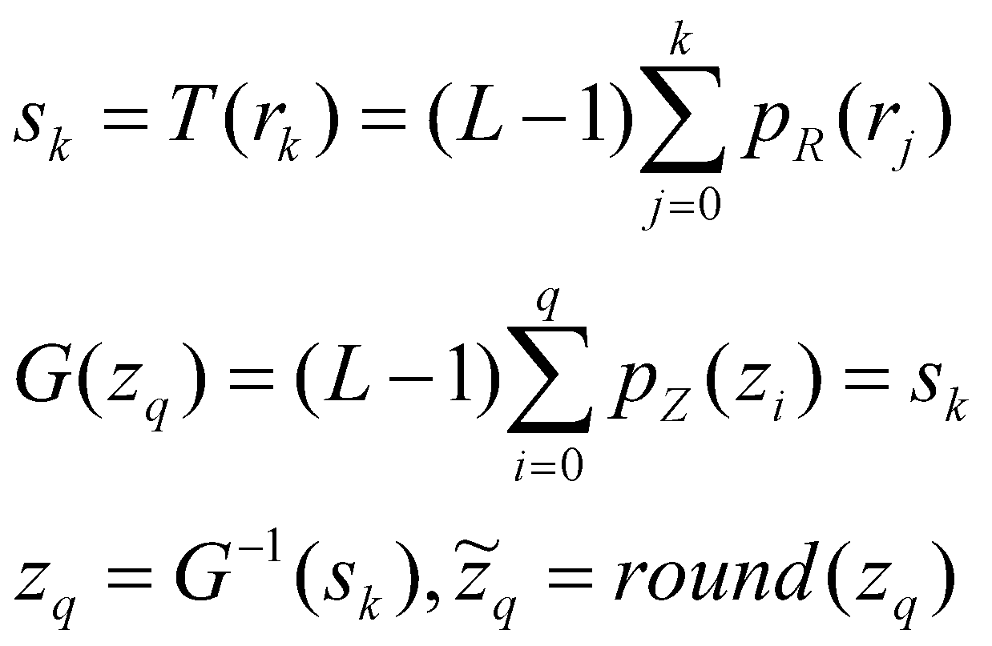
Discrete Representation
The inverse of G is computed via a lookup table. In practice, one evaluates G at all integer values from 0 to L-1. We use the stored values of G to find the integer z_{q} such that G(z_{q}) is closest to s_{k} for each s_{k} value.

Slide 52
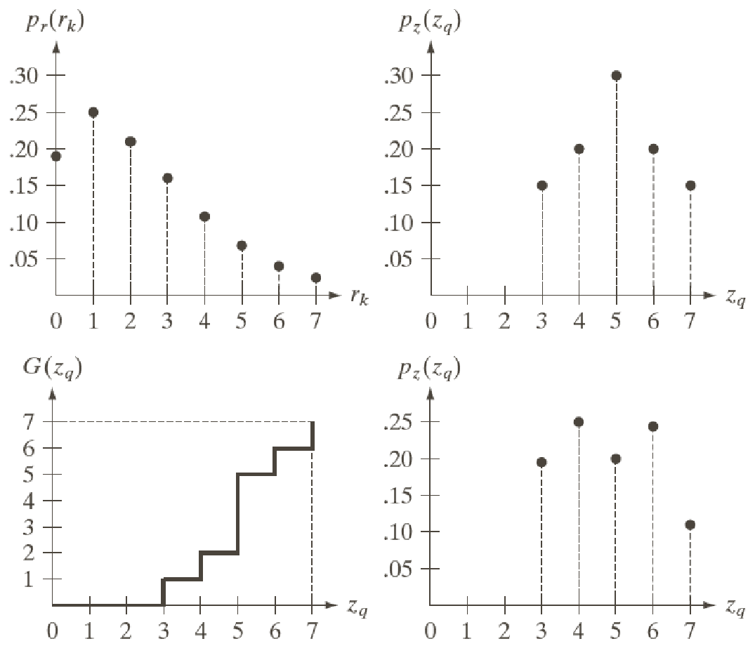
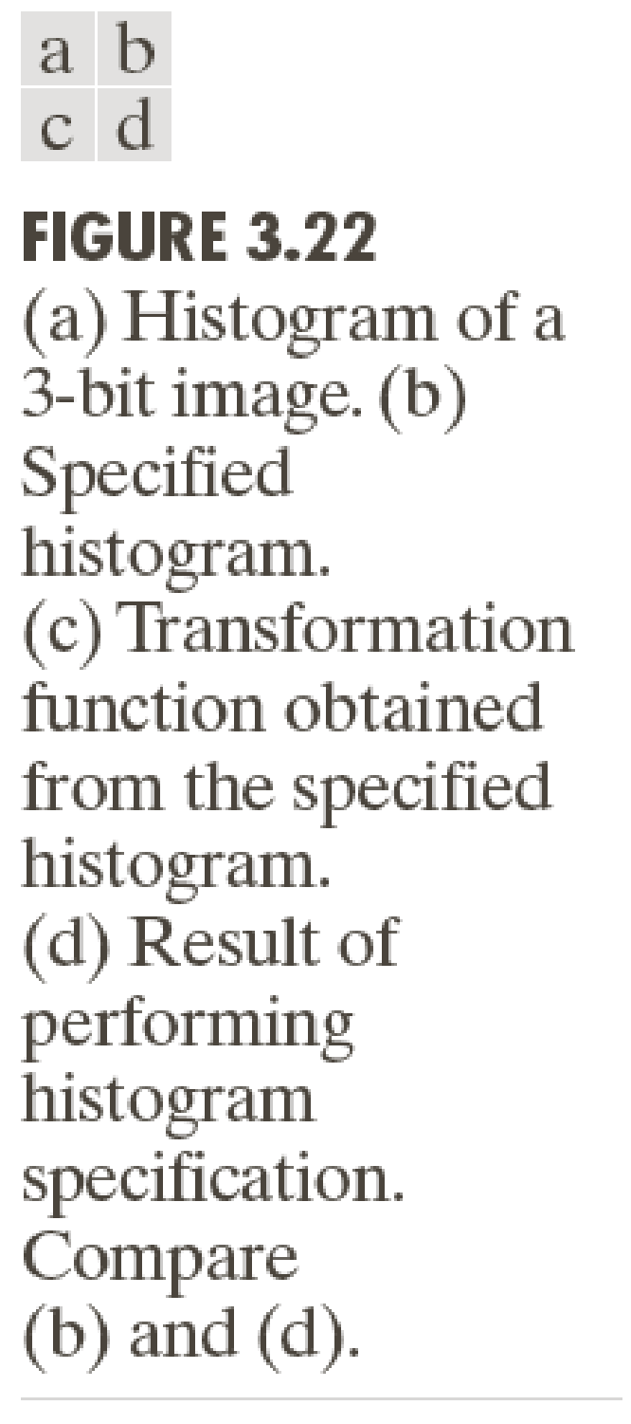
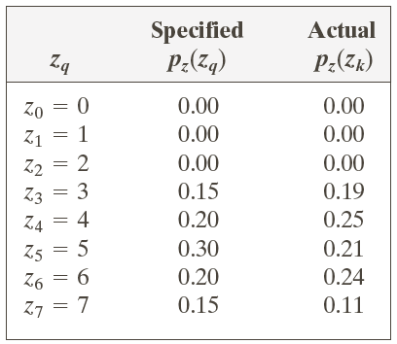
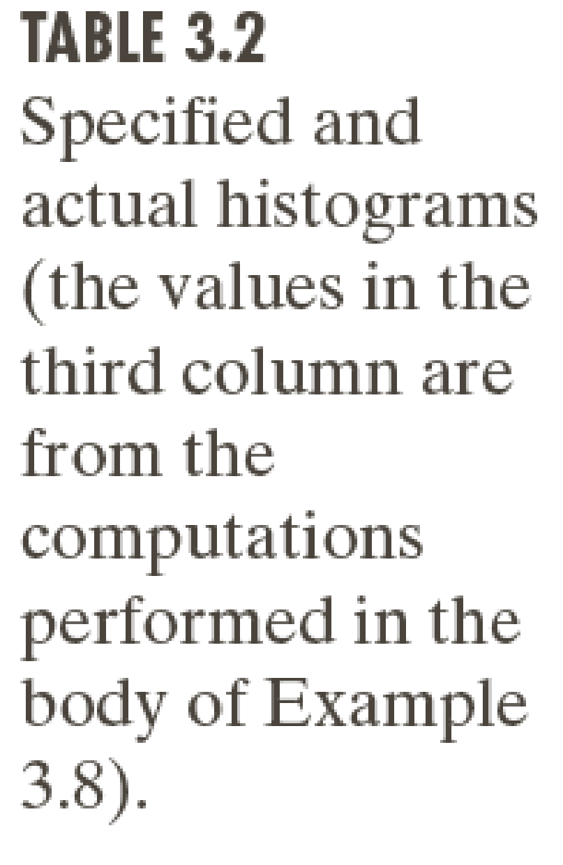

Slide 53
Trial and error
HE and HS are both image enhancement methods.
The choice of whether to use HE or HS, or which histogram to use for the specification in HS, are left to trial and error.
There is no universal way of specifying a histogram for HS.
In fact, HE or HS can be even be done at a “local” level – see next slide.

Slide 54
Local Histogram Equalization
HE/HS – studied so far – are global methods, i.e. pixel intensities are modified by a transformation function affected by intensity values of the entire image.
This approach sometimes does not enhance details in small areas of an image.
Because the number of pixels in small image areas may have an insufficient influence on the global transformation.
Solution: devise transformations based on local histograms.

Slide 55
Local (also called Adaptive) Histogram Equalization
Define a symmetrical neighborhood N(x,y) around any pixel (x,y).
The neighborhood is typically rectangular and has size (say) K x K.
At each (x,y), compute the histogram of intensity values confined to N(x,y).
Compute a transformation based on this local histogram using either HE or HS.
Replace the intensity value of only (x,y) by the transformed intensity.
Repeat for the entire image.
See example on next slide – where global HE (GHE) is unable to enhance the local details in the black squares, but local HE (LHE) with a window size of 3 x 3 is.

Slide 56
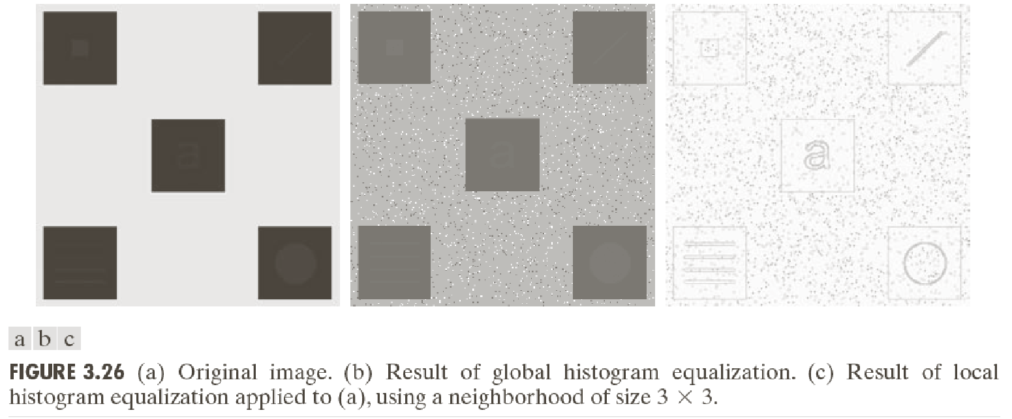

Adaptive means same as local
https://towardsdatascience.com/histogram-equalization-5d1013626e64

Slide 57


Original Image
https://cromwell-intl.com/3d/histogram/
Global histogram-equalized image (see next slide for the results with local HE)

Slide 58


Local histogram-equalized image (size 100 x 100)
Local histogram-equalized image (size 50 x 50)
Ignore the fact that these are color images because color image HE is slightly different and we will study it later. Concentrate on the advantages of local over global.

Slide 59
Spatial Filters

Slide 60

Local Spatial Filters
Change pixel values based on some weighted combination of pixels from a small (often rectangular) neighborhood around the pixel.
This is represented as follows:
The formula is applied for each pixel (x,y) in the pixel domain, using the input signal values.
The output consists of a new “filtered” image g. In most cases, the new values do not replace the values in the original image f.
The weights in w and the neighborhood size are both characteristic features of the filter.
Output image
Input image
Weights

Slide 61

Local Spatial Filters
If the operation performed on the image pixels is linear, we call it a linear filter, otherwise we call it a non-linear filter.
The filtered image is generated as the center of the filter (w(0,0)) visits each pixel (x,y) of the input image f.

Slide 62
Local Spatial Filters
Note: in order to apply a filter to an image, it will usually require zero-padding to accommodate border areas.
Filter mask
Image

Slide 63


Slide 64
Correlation and convolution
Local spatial filters involve one of two operations: correlation and convolution
Correlation = moving a filter mask (2D array consisting of filter weights) over the image and computing the sum of products at each location
This is identical to the previous mathematical formula.

Slide 65
Correlation and convolution
Convolution = identical to correlation except that the filter is first rotated by 180 degrees (in both X and Y directions if it is in 2D) before moving over the image and computing sum of products.

Slide 66

For a filter of size m (in 1D), pad with m-1 zeros on either side

Slide 67
Correlation and convolution
In the preceding example, we consider a 1D image with all zeros except a single one - called a unit impulse (or a Kronecker delta) function.
The result of correlation with a filter with mask w is a reverse copy of w, centered at the location of the impulse.
The result of convolution with a filter with mask w is a copy of w, centered at the location of the impulse.
We will see the same result on the next slide in 2D.

Slide 68



Slide 69

Correlation and convolution
Correlation (denoted by an empty asterisk in the book)
Convolution (denoted by a solid black asterisk in the book)
Notes:
The negative signs in the formula for the convolution, which represents flipping by 180 degrees. You would get similar formulae in 1D as well.
Intuitively: correlation between a mask and a unit impulse signal yields a reversed copy of the mask. If we pre-rotate the mask by 180 degrees, we will now get a copy of the mask.
If w were symmetric, then convolution and correlation yield identical results.

Slide 70

Correlation and convolution
Convolution is a commutative operation!
Repeat this exercise for correlation - it is NOT commutative (work out a counter-example).
After zero-padding w and f so that they have infinite extent. Note this doesn’t change the summation value.

Slide 71

Correlation and convolution
Convolution is an associative operation!
Correlation is not associative.
The proofs of these results are much easier when using Fourier transforms (which we will study later).

Slide 72
Genesis of convolution
Consider a system which takes in input signal x(t) and produces an output y(t) where y(t) = T[x(t)].
T is the transformation that is executed by the system.
Consider that T satisfies two conditions: linearity and time-invariance.

Slide 73



Genesis of convolution
Consider that T satisfies two conditions: linearity and time-invariance.
Let the signal x be a unit impulse δ(t) at 0 (Kronecker delta function).

Slide 74

Genesis of convolution
The output of the system for a unit impulse input is called its impulse response h(t).
It turns out that the response of a linear time-invariant (LTI) system to any input signal x is the convolution of the signal with the impulse response of the LTI system.

Slide 75



Genesis of convolution: Proof
Note: This specific example talks about 1D systems, but the same theory is applicable for 2D signals (where the shifts will be in 2D) or any higher dimension.

Slide 76

Genesis of correlation
Correlation gives the similarity between a signal w and (a shifted version) of a signal f.
Correlation is large for those shifts x for which w and shifted f have similar values, or even similar signs.
It can be used for template matching.

Slide 77




Search for the template (Messi’s face) inside the larger image in the middle.
First row: On the left you have the cross-correlation map
Second row: On the left you have the normalized cross-correlation map
Why is the latter superior to the former? Notice the false match in the top row and the correct match in the second one.
https://docs.opencv.org/4.5.2/d4/dc6/tutorial_py_template_matching.html

Slide 78


Types of image noise
Gaussian noise: addition of perturbations to an image, the perturbations are random numbers from the Gaussian distribution.
Examples of Gaussian noise: Film grain noise, thermal noise in a camera
Symbol for Gaussian distribution with mean 0, standard deviation σ
Formula for Gaussian distribution with mean μ, standard deviation σ

Slide 79



Types of image noise
Impulse noise: random large magnitude perturbations at a few pixels – example: flicker artifacts in old movies, or blotches in old photographs.
Note: Gaussian noise typically affects all pixels but by a smaller magnitude.
Low σ, Gaussian
High σ, Gaussian
Impulse

Slide 80

Mean filter
Replace the central pixel value by arithmetic mean of all surrounding pixel values.
This acts as a smoothing filter.
Image noise means random transition in the intensity values – these get attenuated by mean filter.
But edges (boundaries between regions with different colors) get blurred as well ☹

Slide 81
Mean filter
Implemented by convolving the image with a mask contains all values equal to 1/(2a+1)².

Slide 82



Original image
Noisy image
-Amount of smoothing is directly proportional to the width of the filter window.
-Repeated application of a mean filter will lead to a constant intensity image in the limit of infinite iterations
Filtered image

Slide 83



Slide 84


Weighted mean filter
Assign different weights to each pixel: weigh pixels located closer to the center of the window more than those towards the edge of the window.
Decay parameter
Gaussian weights
Called the 2D Gaussian function

Slide 85
Weighted mean filter
Also does not preserve edges.
Note: we want all the weights to sum up to 1, otherwise the dynamic range of the image will not be preserved!
What’s special about the Gaussian function? It gives more weights to image pixels near the center of the mask and lower weights to pixels farther away from the center.

Slide 86



Weighted mean filter
Implemented by convolving the image with a mask containing weights of the form

Slide 87

Median Filter
When there are wild outliers (such as impulse noise, also called salt and pepper noise) in the image, the mean filter gives a poor response.
Common when there are data transmission errors, common in old film recordings.
Median: more robust to large outliers in a given dataset.
Median filters – give better preservation of features under impulse noise than mean filter.
Equation for median filter:

Slide 88
Median versus mean: try out
Compute mean and median of [1:100], i.e. an array of all integers from 1 to 100.
Change one of the numbers in the array to a large value (like 10000)
Re-compute the mean and median.
The mean changes drastically, the median remains almost the same – as long as these drastic changes affect less than half the number of elements in the array.

Slide 89




Median Filter
Original
With salt and pepper noise
5 x 5 Mean filter
5 x 5 Median filter
Much better feature preservation with median filter

Slide 90


Comparing mean and median filter
http://homepages.inf.ed.ac.uk/rbf/HIPR2/median.htm
Median filter: MUCH better than mean filter for impulse noise.
Preserves edges better than mean filter, but creates artifacts in smoother regions.
High σ, Gaussian
3 x 3 Median
3 x 3 Mean

Slide 91


Works quite well even with strong impulses, provided most neighborhoods have no more than 50 percent of the pixels corrupted.

Slide 92

Original and noisy (impulse corrupted) images
Median filter outputs – given filters of size 3 x 3 and 5 x 5
http://what-when-how.com/embedded-image-processing-on-the-tms320c6000-dsp/non-linear-filtering-of-images-image-processing-part-1/

Slide 93
Linear and non-linear filters
The mean filter is a linear filter:
It is also space invariant.
So it can be implemented as a convolution.
The median filter cannot be implemented using a convolution as it is nonlinear.

Slide 94


Sharpening filter
Smoothing filters – local average (integration)
Sharpening filters – local intensity derivatives (differentiation) to enhance local distinctive features

Slide 95

sharpening

Slide 96
Sharpening filters
Mean filter = local averaging filter
Averaging causes blurring, equivalent to integration.
Sharpening – uses intensity differentiation
We will compute local image intensity derivatives.
Greater the derivative magnitude = sharper change in intensity.
Aim: to add back local derivative magnitudes to the low-contrast image!

Slide 97



Digital Derivative Operators (1D)
Assume 1-D image for now, i.e. our image is f(x) instead of f(x,y)
1st derivative: Zero in constant areas, non-zero at the onset of an intensity ramp or intensity step, non-zero along a ramp
2nd derivative: Zero in constant areas, zero along intensity ramps of constant slope, non-zero at the onset and end of an intensity ramp or step

Slide 98

Intensity discontinuity, also called step edge
From book by Gonzalez and Woods

Slide 99

From book by Gonzalez and Woods

Slide 100
Digital derivatives: first versus second
Along a ramp (i.e. intensity change with constant slope), first derivative is a non-zero constant.
Second derivative is zero along the ramp, except at the start and end!
Second derivative is preferable for image sharpening! Many edges in images are ramp-like, in which case first derivative will give thick edges (undesirable), whereas second derivative gives thin edges two pixels wide (desirable).
Second derivative changes sign midway at a step edge (zero crossing property).

Slide 101
Laplacian of an image
Images are 2D – what kind of second derivative do we use? Along X or Y direction?
We look at isotropic operators, i.e. operators whose output does not depend upon the direction of image intensity discontinuity.
That is, we are interested in rotationally invariant 2nd derivative operator for images.

Slide 102
Laplacian of an image
A filter is said to be rotationally invariant if rotating the image and then applying the filter to the rotated image gives the same result as applying the filter to the image and then rotating the result.

Slide 103


Laplacian of an image
Rotationally symmetric operator (in the continuous domain)
Laplacian operators: second operator is obtained by adding second derivatives along both the diagonals, to the first operator

Slide 104
Laplacian of an image
The two masks on the previous slide are applied point-wise to the entire image.
For image smoothing as well, we applied point-wise masks.
But here the mask weights sum to 0. In smoothing the weights summed to 1.

Slide 105

Laplacian for image sharpening
A Laplacian de-emphasizes regions with slowly varying intensities.
Highlights intensity discontinuities in an image.
Subtracting the Laplacian from an image yields sharpening:

Slide 106
Laplacian for image sharpening
Subtracting the Laplacian from an image yields sharpening:
Why is this the case?
Observe that the Laplacian changes sign across an edge.
For an edge with decreasing intensity, it is negative and positive at the beginning and end of the edge respectively.
Hence deducting it sharpens the edge. See diagram on next slide

Slide 107
Intensity discontinuity, also called step edge
From book by Gonzalez and Woods
sharpened edge: 6-(-1) = 7 at the beginning and 1-1=0 at the end.

Slide 108


Laplacian for image sharpening
In some books, the following masks are used for the Laplacian (they are equal to the earlier masks multiplied by -1):
With such masks, the sharpening filter is expressed as:

Slide 109


From Book by Gonzalez and woods

Slide 110

Sharpening filter: convolution mask

Slide 111

https://en.wikipedia.org/wiki/Unsharp_masking

Slide 112
Unsharp masking
Smooth the original image f using a filter g yielding f1 = f*g.
Compute the difference between original and smoothed image, i.e. f2 = f-f*g.
Add it back to the original image to yield f3 = f + k f2 for some scalar k.
You get a sharpened image.
If k = 1, we call it unsharp masking (i.e. removing blurred components)
If k > 1, we term it highboost filtering.

Slide 113


From Book by Gonzalez and woods

Slide 114



Slide 115
Derivative filters: dealing with noise
Derivative filters in general exacerbate noise.
Hence they are applied in conjunction with smoothing filters.
For example, the Sobel filters smooth in the X and Y directions before performing differencing.

Slide 116



Slide 117




Grayscale image
Gradient map (after applying Sobel filter)
X-Sobel filter output
Y-Sobel filter output

Slide 118

Sobel filters: outer products
Filter which can be represented in this outer-product form are called separable filters.
Convolution between a M x N image and a K x L mask has a complexity of O(MNKL), which can be expensive.
But with separable filters, this reduces to O( MN [L+K]) since you express the K x L mask as the outer product of K x 1 mask and a 1 X L mask. Applying the 1 X L mask requires O(MNL) operations whereas applying the K x 1 mask requires O(MNK) operations. Here, we are using the associativity of convolution.

Slide 119

Other examples of separable filters

Slide 120


Laplacian of Gaussians
The image Laplacian is susceptible to noise.
Hence the image f is first convolved with a Gaussian of std. dev. σ to smooth some of the noise, and then the Laplacian is applied, i.e. we compute: .
Equivalent to , due to associative and commutative nature of convolution.

Slide 121

Laplacian of Gaussians
For efficiency, the Laplacian of Gaussians mask is pre-computed.
The formula for this is:

Slide 122


Discrete approximation with σ=1
https://homepages.inf.ed.ac.uk/rbf/HIPR2/log.htm

Slide 123


https://homepages.inf.ed.ac.uk/rbf/HIPR2/log.htm
LoG filter of size 7 x 7 with σ=1

Slide 124
Bilateral Filters

Slide 125
Bilateral filter versus mean/median filter
Mean filter: does not preserve image edges
Median filter: too may not always preserve edges
To preserve edges well, we may need a non-linear filter
Bilateral filter is one such

Slide 126

Gaussian blur
https://people.csail.mit.edu/sparis/bf_course/course_notes.pdf
The median filter will assign the median of the values in the red neighborhood to the corner pixel – and will convert the otherwise black pixel to a yellow one (as most of the pixels in the neighborhood are yellow). Thus the median filter does not always preserve edges well!

Slide 127


Bilateral Filter
Intensity-based weights
Space-based weights
Effect of parameter σ_{s}:
As it increases, a larger and larger neighborhood of values around p =(x,y) will contribute to the averaging (more noise reduction but possible contribution from dissimilar regions)
As it shrinks towards 0, fewer and fewer neighbors of the central pixel p will contribute to the averaging
Effect of parameter σ_{r}:
For moderate values, only intensities close to I(p) will affect the averaging
For larger values, the bilateral filter will begin to resemble a Gaussian filter
Features or edges with intensity difference less than σ_{r} will be blurred, others will be preserved

Slide 128

https://people.csail.mit.edu/sparis/bf_course/course_notes.pdf

Slide 129

https://people.csail.mit.edu/sparis/bf_course/course_notes.pdf

Slide 130






https://homepages.inf.ed.ac.uk/rbf/CVonline/LOCAL_COPIES/MANDUCHI1/Bilateral_Filtering.html

Slide 131
Bilateral filter implementation
A bilateral filter cannot be implemented as a convolution for two reasons.
The weights themselves depend on the intensity values of the original (noisy) image.
The weights change from pixel to pixel.
Thus the filter is neither linear nor space-invariant

Slide 132
Cross-bilateral filter
Consider a noisy no-flash and a non-noisy flash image of the same scene.
The latter has changes of color in the scene due to the flash
Cross-bilateral filter: apply a bilateral filter to the n0-flash image with intensity/range weights from the flash image

Slide 133

http://hhoppe.com/flash.pdf

Slide 134

http://hhoppe.com/flash.pdf

Slide 135
Staircase effect of the bilateral filter
https://people.csail.mit.edu/sparis/bf_course/course_notes.pdf

Slide 136
Staircase effect of the bilateral filter
The bilateral filter has a tendency to create artificial edges in homogenous regions.
Why? Look at a 1D example – next slide.
The signal is locally concave (line joining two points is above the curve).

Slide 137

https://hal.archives-ouvertes.fr/hal-00271143/document

Slide 138
Staircase effect of the bilateral filter
We are looking at pixels (y) whose intensities are within a range of u(x)-h to u(x)+h where h is approximately 3σ_{r}.
But the number of points such that u(x)-h < u(y) <= u(x) is more than the number of points for which u(x) < u(y) <= u(x)+h.
So effectively, the filtered intensity value is less than the original intensity value u(x).
For a locally convex signal (line joining two points is below the curve), the filtered intensity value is more than the original value u(x).
At points where locally convex and locally concave parts meet (called inflection points), you get an artificial increase in contrast – causing the staircase effect.

Slide 139
Bokeh Filters

Slide 140
Bokeh filters
Bokeh is an effect in photography where the main object is in focus and the rest of the scene is severely defocussed.
This produces a pleasing aesthetic effect.

Slide 141

https://en.wikipedia.org/wiki/Bokeh#/media/File:Josefina_with_Bokeh.jpg

Slide 142

https://en.wikipedia.org/wiki/Bokeh

Slide 143
Bokeh
The amount of blur is depth dependent.
Certain areas are in focus, the rest are not and lie in a “circle of confusion”.
The depth of field of a camera is the region where the circle of confusion has a size less than the resolution of the human eye.

Slide 144


Shallow depth of field
https://en.wikipedia.org/wiki/Bokeh

Slide 145
Bokeh
Bokeh characteristics may be quantified by examining the image's circle of confusion. In out-of-focus areas, each point of light becomes an image of the aperture, generally a more or less round disc.
Bokeh can be simulated by convolving the image with a kernel that corresponds to the image of an out-of-focus point source taken with a real camera.
Unlike conventional convolution, this convolution has a kernel that depends on the distance of each image point and – at least in principle – has to include image points that are occluded by objects in the foreground.^{[28]}
Also, bokeh is not just any blur. To a first approximation, defocus blur is convolution by a uniform disk, a more computationally intensive operation than the "standard" Gaussian blur; the former produces sharp circles around highlights whereas the latter is a much softer effect.

Slide 146

From left to right: an original photo with no bokeh or blur; the same photo with synthetic bokeh effect applied to its background; the same photo with Gaussian blur applied to its background
https://en.wikipedia.org/wiki/Bokeh

Slide 147

Source: https://web.ics.purdue.edu/~tmcgraw/papers/dof_mcgraw_2014.pdf

